Slide 1






ADVERTISING ON FACEBOOK
Facebook is an online social media and social networking service owned by American company Meta Platforms. Founded in 2004 by Mark Zuckerberg

Slide 2

CONTENT
targeted marketing ads on facebook
eXPLORE AND VISUALIZE
Split dataset on train and test sets
IMPutation missing values
mACHINE LEARNING MODEL:
(naïve BAYES CLASSIFICATION, BAGGING CLASSIFICATION, K-NEIGHBORS CLASSIFICATION, RANDOM FOREST CLASSIFICATION, LOGISTIC REGRESSION, SUPER LEANER)
CONCLUTION

Slide 3
PROJECT STRUCTURE
1
Introduction
2
target
Problem definition
task
3
Data Analysis
4
Feature Engineering
5
Feature Selection
6
Discretization
7
Scaling
8
Training model
9
Evaluation Results

Slide 4




Python data analysis libraries
Pandas for processing and analysis
of structured data
​
Anaconda is a distribution of the Python to simplify package management and deployment
Numpy for used for
mathematical calculations, statistics, matrix
Matplotlib for data visualization
Seaborn for data visualization​

Slide 5

ANALYSIS OF DATA

Slide 6
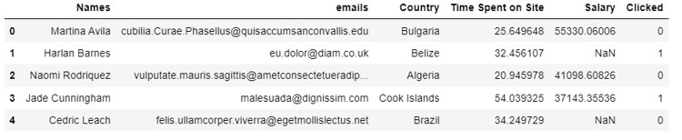
ANALYSIS DATASET​
5 Indepent variables
1 depent variables
1 Names
2 emails
3 Country
4 Time Spent on Site
5 Salary
6 Clicked
208 country
MIN: 5 min​, MAX: 60 min
MIN: $20​, MAX: $100 000

Slide 7
TARGETED MARKETING ADS ON FACEBOOK​
You have been hired as a consultant to a start-up that is running a targeted marketing ads on Facebook. The company wants to analyze customer behavior by predicting which costumer clicks on the advertisement.​
​
Customer data is as follows:​
Inputs:​
Name​
e-mail​
Country​
Time on Facebook​
Estimated Salary (derived from other parameters)​
​
Outputs:​
Click (1: customer clicked on Ad, 0: customer did not click on Ad)
TOTAL: 499 rows, 6 columns​
There are 1 binary variables : Clicked​
There are 2 continuous variables: Time​ Spent on Site, Salary​
There are 3 categorical variables: Name, e-mail, Country

Slide 8
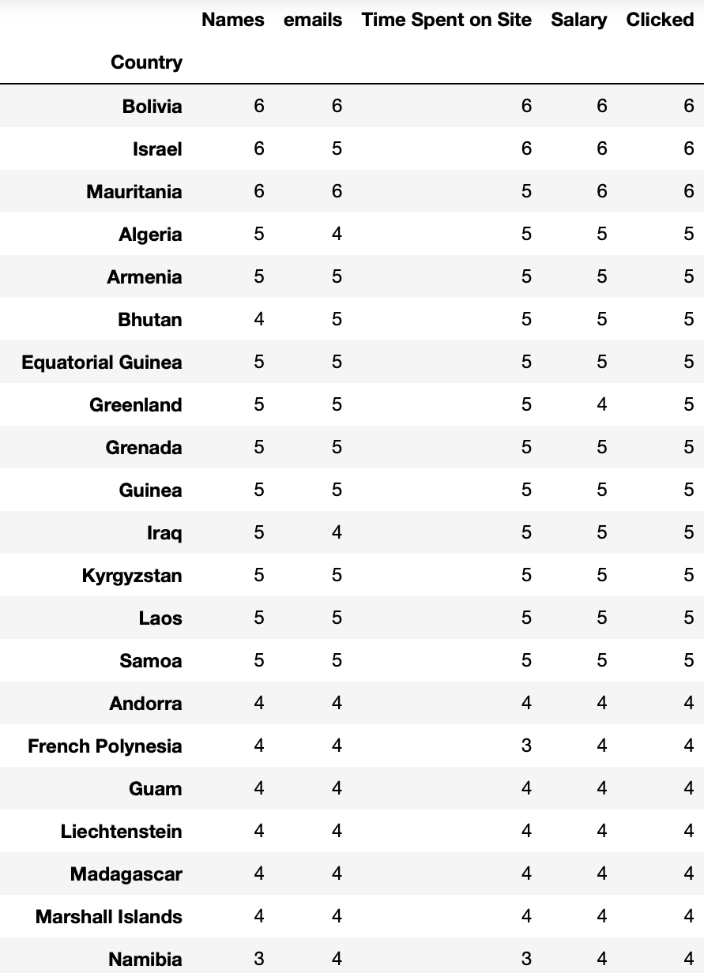
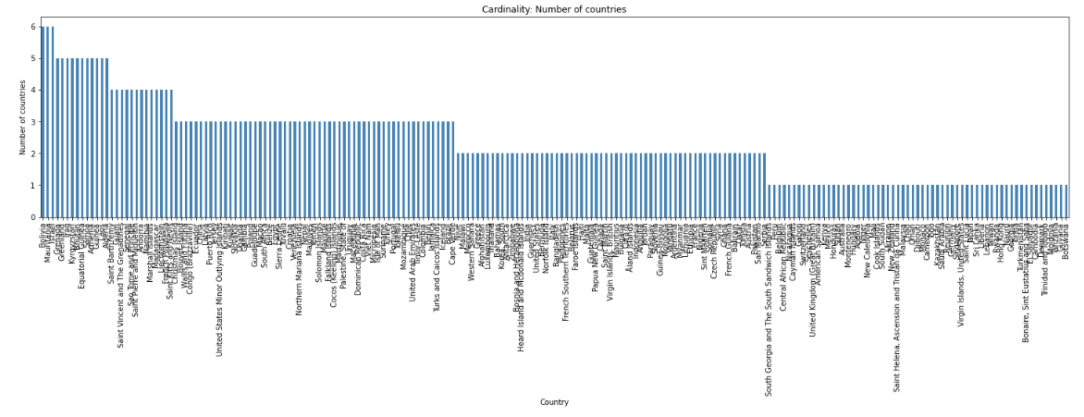
CARDINALITY OF COUNTRIES
Countries : VietNam, Marshall Islands, Germany, Kyrgyzstan, Gambia, Reunion, Jordan, Slovakia, Kiribati, United States Minor Outlying Islands, Puerto Rico, Guinea, Guam, China, Ecuador, Anguilla, Kazakhstan, Jersey, Macao, Indonesia, Ghana, Cameroon, Myanmar, Central African Republic,Bolivia, Egypt, Tuvalu, Qatar, Venezuela, Togo, Nepal, Saudi Arabia,San Marino, etc.

Slide 9
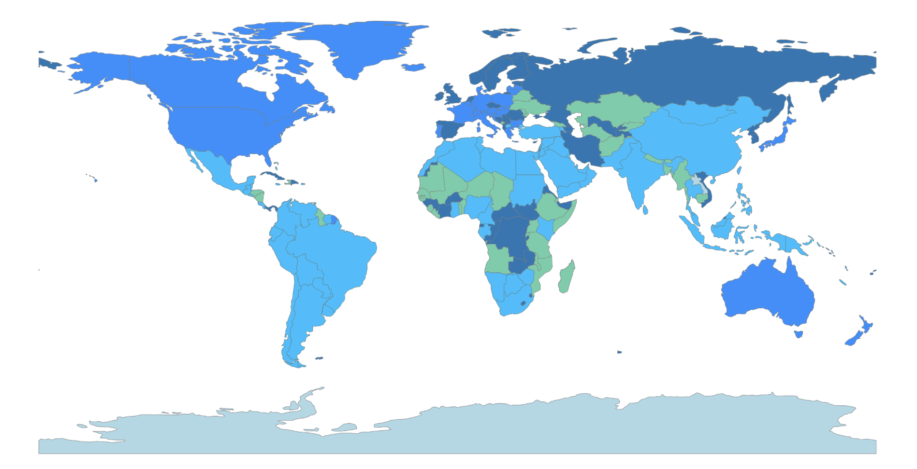
COUNTRIES INTERESTED IN ADS
Countries from which people clicked on the advertisement on site.
Dodgerblue shown developed countries,
Skyblue – developing countries,
Green – others countries,
Darkblue – our dataset has no this countries.

Slide 10
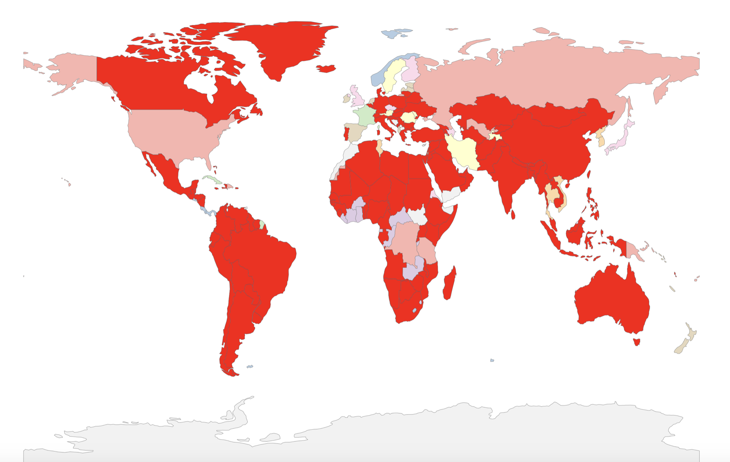
COUNTRIES INTERESTED IN ADS
Countries from which people clicked on the advertisement on site is red.

Slide 11
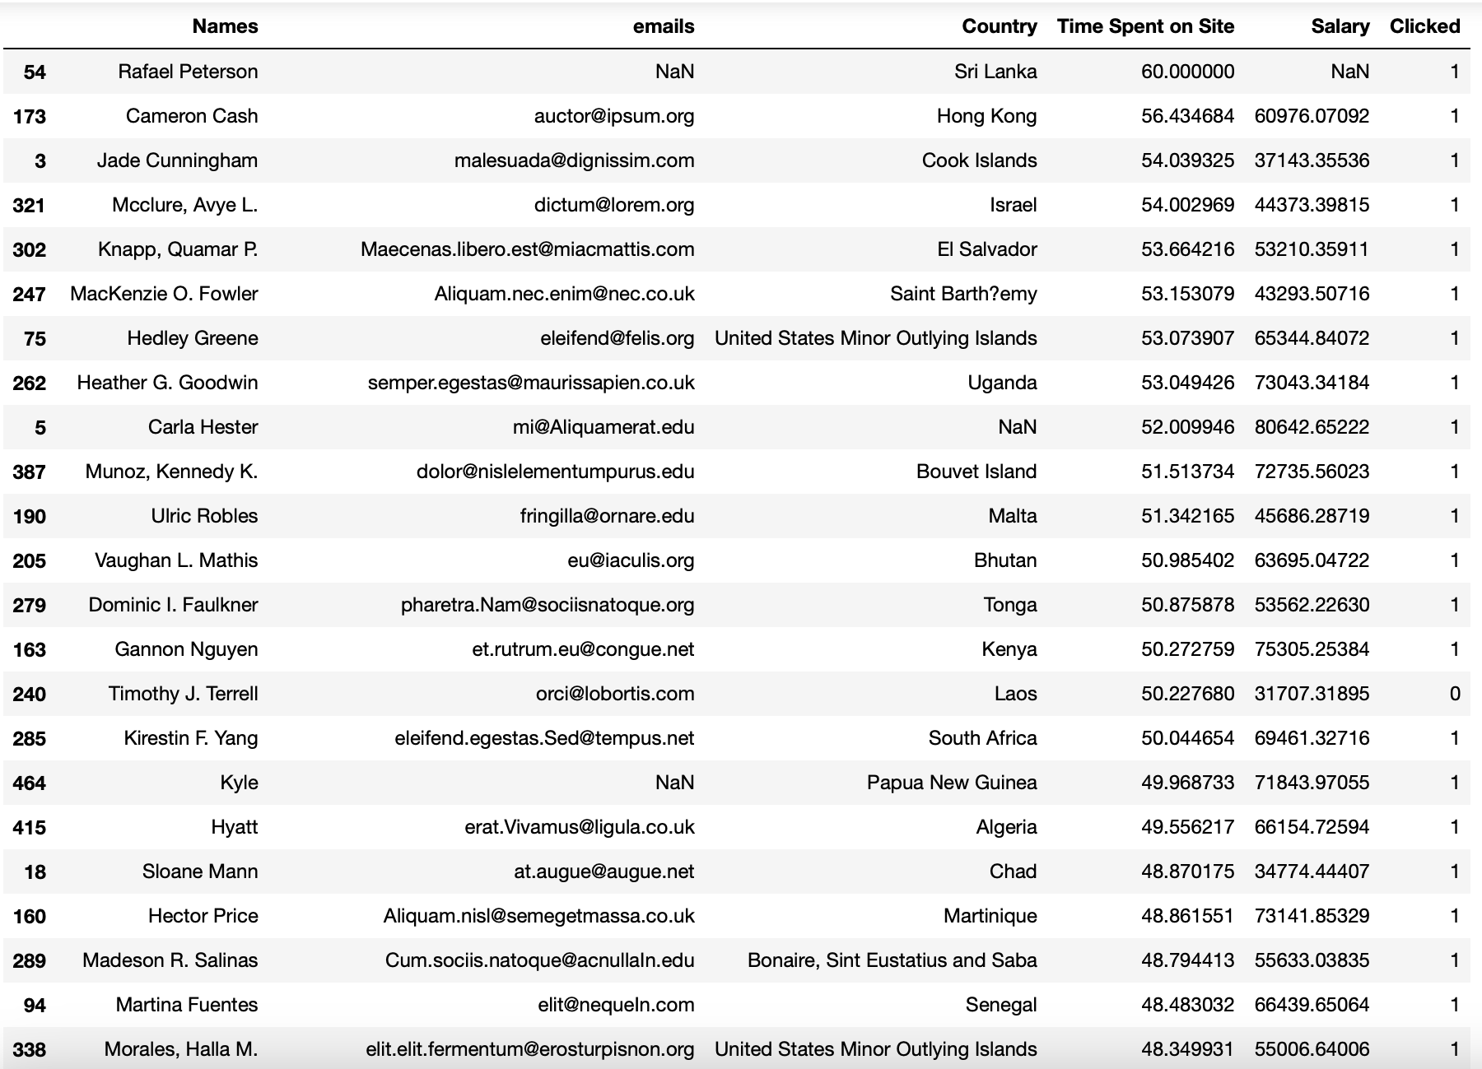
TIME SPENT on SITE FROM MAXIMUM TO MINIMUM
Sri Lanka
Hong Kong
Cook Islands,
Israel,
El Salvador
Saint Bathemy
United States Minor Outlying Islands
Uganda*
Bouvet Island
Malta
Bhutan, etc

Slide 12

DISTRIBUTION GRAPH

Slide 13
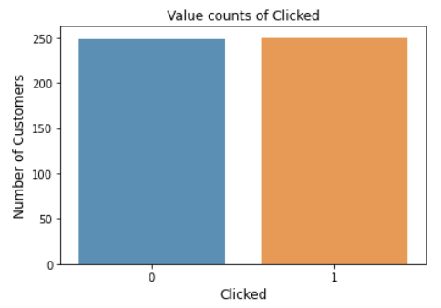
PROPORTION PERCENTAGE
TOTAL 499
NUMBER OF CUSTOMER WHO CLIKED ON AD = 250
PERCENTAGE CLICKED = 50.1%
DID NOT CLICK = 249
PERCENTAGE WHO DID NOT CLICK = 49.89%
Click = 1 (orange) ​​
No click = 0 (blue)

Slide 14
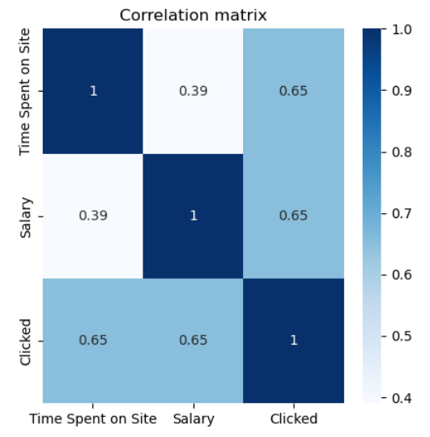
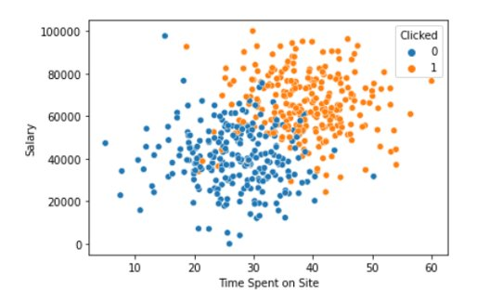
Distribution regarding salary and time spent on the site Facebook
Click = 1 (orange)
No click = 0 (blue)

Slide 15
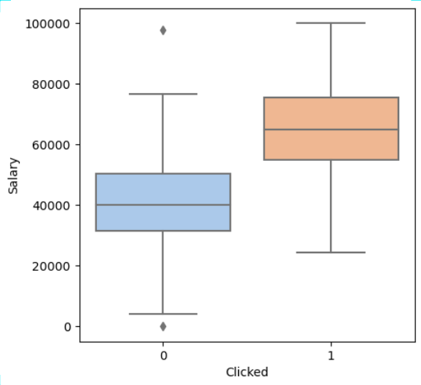
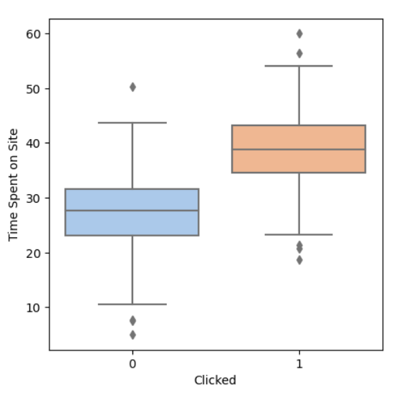
Distribution regarding Salary
Distribution regarding Time spent on site
Click = 1 (orange) ​
No click = 0 (blue)

Slide 16
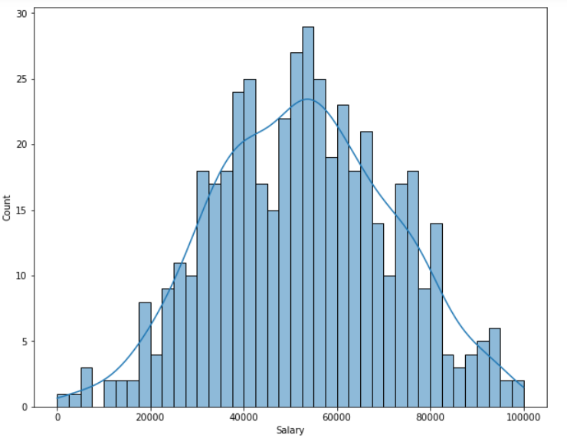
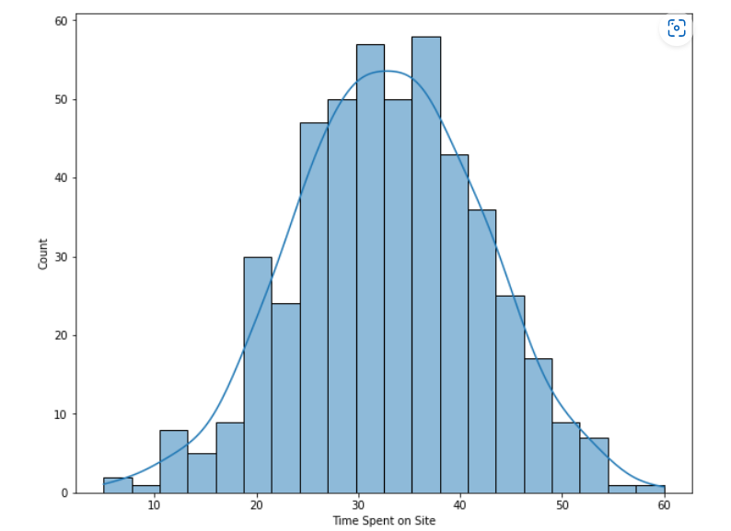
DISTRIBUTION GRAPH
Salary
Time spent on the site

Slide 17
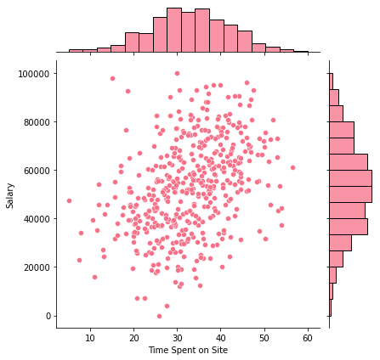
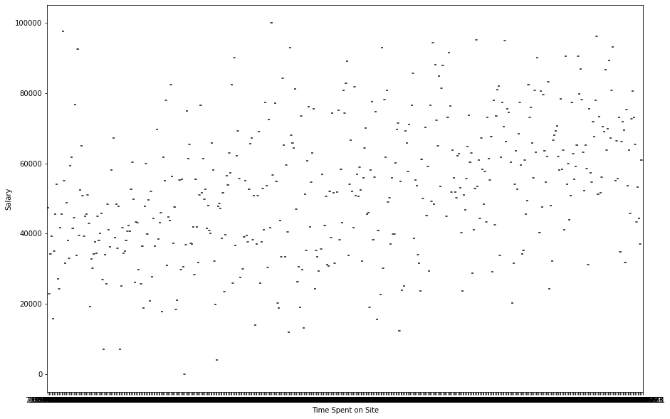
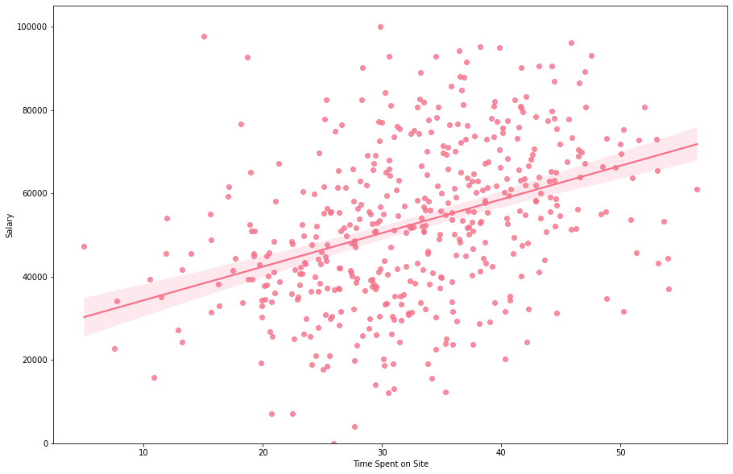
DISTRIBUTION GRAPH
Salary
Salary
Time spent on the site
Time spent on the site

Slide 18
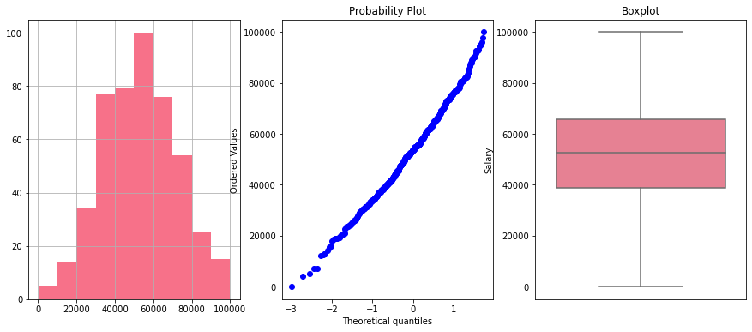
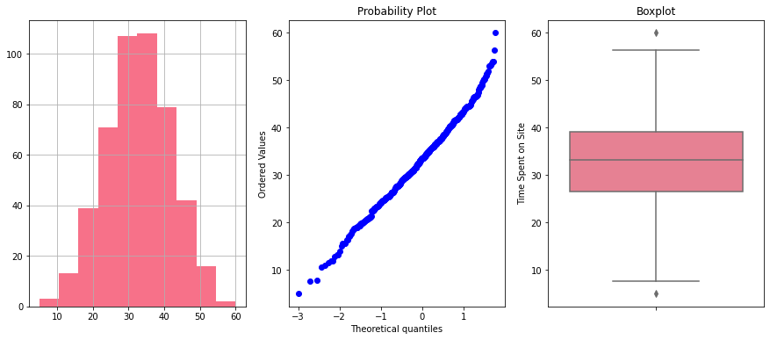
DISTRIBUTION, PROBABILITY PLOT, BOX PLOT
Salary
Time spent on the site

Slide 19
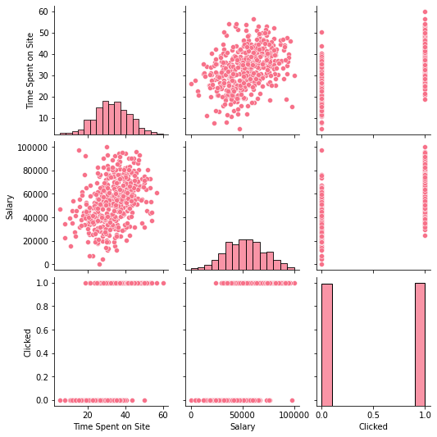
Time spent on the site
Salary
Clicked

Slide 20
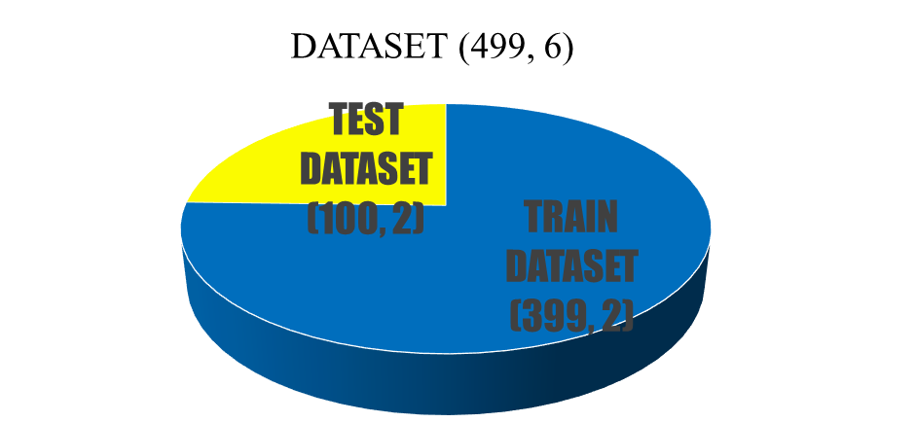
SPLIT DATASET ON TRAIN AND TEST SETS
DROP VARIABLES : 'Names', 'emails','Country'
25%
75%

Slide 21


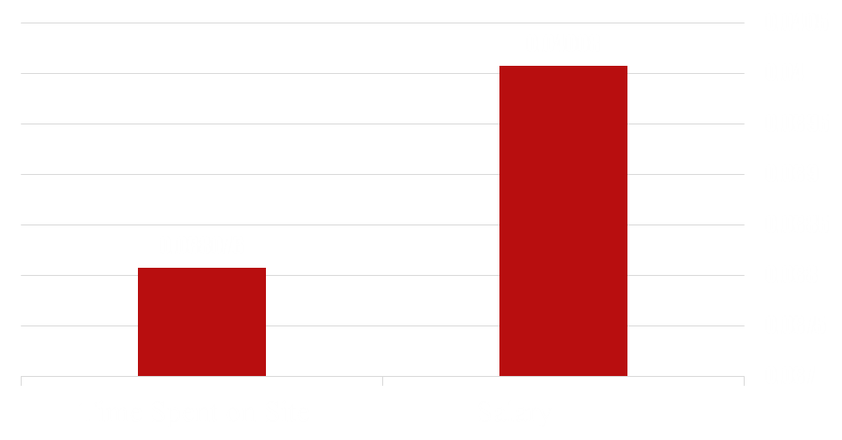
Missing data in dataset
Time Spent on Site 0.038076
Salary 0.040080

Slide 22
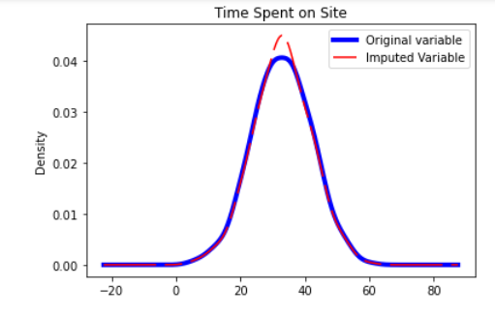
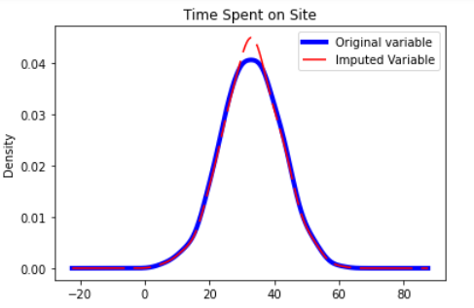
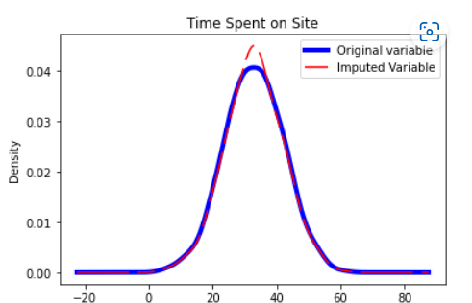
mean
median
constant
Original variable variance: 83.7
Variance after imputation: 80.5
Before and After
Simple Imputer mean, median, constant

Slide 23
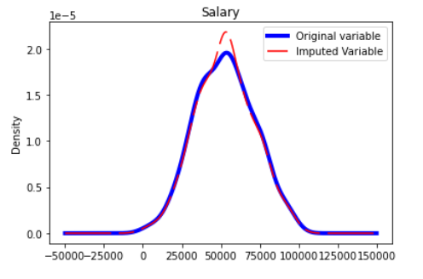
Before and After​ Simple Imputer mean
Original variable variance: 360410001.7
Variance after imputation: 345935704.4

Slide 24
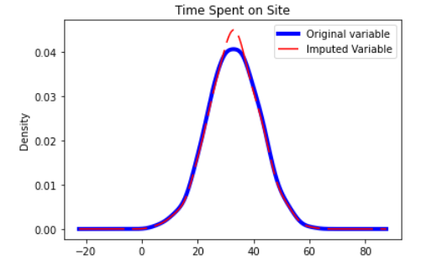
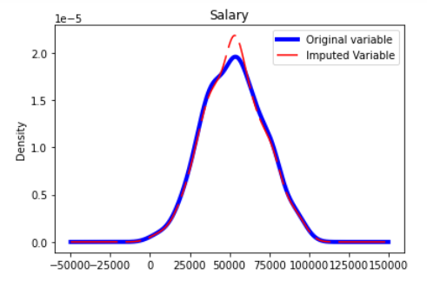
Before and After​ KNN Imputer
Original variable variance: 83.7
Variance after imputation: 80.5
Original variable variance: 360410001.7
Variance after imputation: 345935704.4

Slide 25
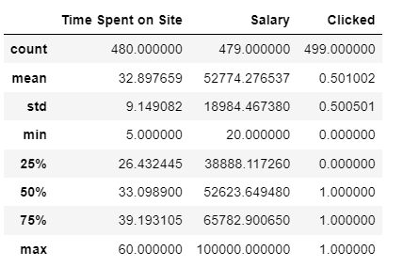
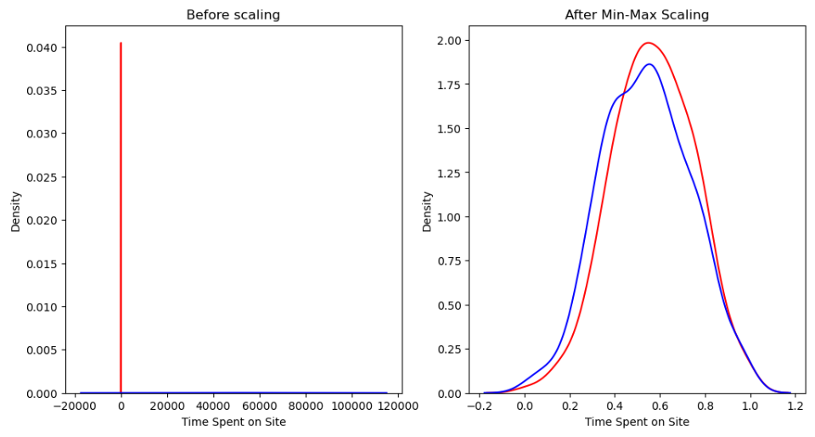
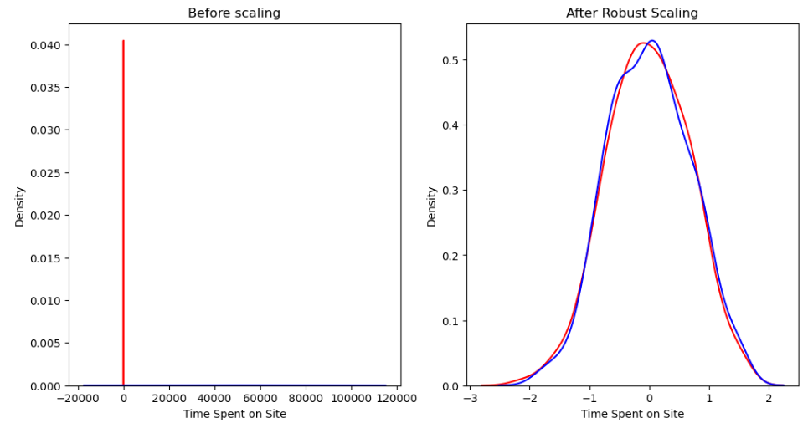
feature magnitude
Scaler Before and After
Min Max Scaler
Robust Scaler

Slide 26
TRAINING MODELS
MACHINE LEARNING MODEL:​
BAGGING CLASSIFICATION
K-NEIGHBORS CLASSIFICATION
RANDOM FOREST CLASSIFICATION
LOGISTIC REGRESSION
SUPER LEANER
NAÏVE BAYES CLASSIFICATION

Slide 27
NAÏVE BAYES CLASSIFICATION
Naïve bayes clasification Grid_search best_parameters:
{'GNB__priors': None, 'GNB__var_smoothing': 1e-08, 'discretizer__bins': 15, 'imputer_num__imputation_method': 'mean'}
Train set GaussianNB roc-auc: 89%
Test set GaussianNB roc-auc: 86 %

Slide 28
BAGGING CLASSIFICATION
Bagging Classification Grid search Best parameters:
{'Bagging_Classifier_n_estimators': 10,
'discretizer_bins': 7,
'imputer_num_imputation_method': 'median'}
Train set BaggingClassifier roc-auc: 91%
Test set BaggingClassifier roc-auc: 85%

Slide 29
K-NEIGHBORS CLASSIFICATION
KNC Grid_search Best_parameters:
{'KNC__algorithm': 'ball_tree', 'KNC__leaf_size': 30, 'KNC__n_neighbors': 11, 'KNC__weights': 'uniform', 'discretizer__bins': 15, 'imputer_num__imputation_method': 'mean'}
Train set KNC roc-auc: 90%
Test set KNC roc-auc: 83%

Slide 30
Random FOREST CLASSIFIER
RFC Grid_search Best_parameters:
{'RFC__criterion': 'entropy', 'RFC__max_depth': 5, 'RFC__max_features': 'auto', 'RFC__n_estimators': 100, 'discretizer__bins': 15, 'imputer_num__imputation_method': 'mean'}
Train set RFC roc-auc: 91%
Test set RFC roc-auc: 86%

Slide 31
LOGISTIC REGRESSION
LR Grid_search Best_parameters:
{'LR__C': 0.5, 'LR__max_iter': 100, 'LR__penalty': 'l1', 'LR__solver': 'liblinear', 'discretizer__bins': 9, 'imputer_num__imputation_method': 'median'}
Train set LR roc-auc: 89%
Test set LR roc-auc: 87%

Slide 32

Super Leaner
Confusion matrix:
[[43 5] [10 42]]
Precision score: 89%
Recall score: 80%
Accuracy score: 85%
f1_score: 84%

Slide 33
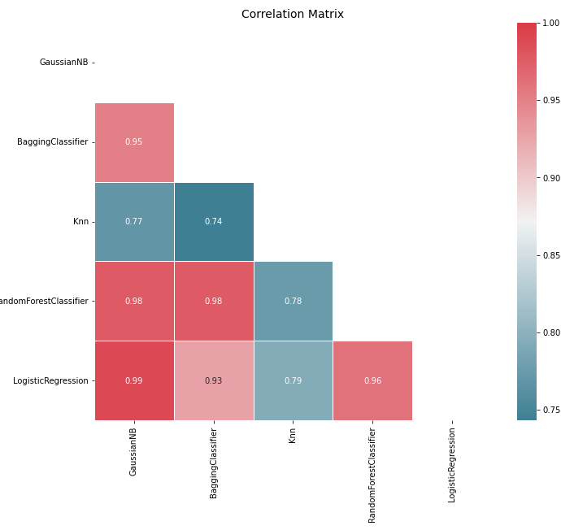
Correlation Matrix of Models

Slide 34
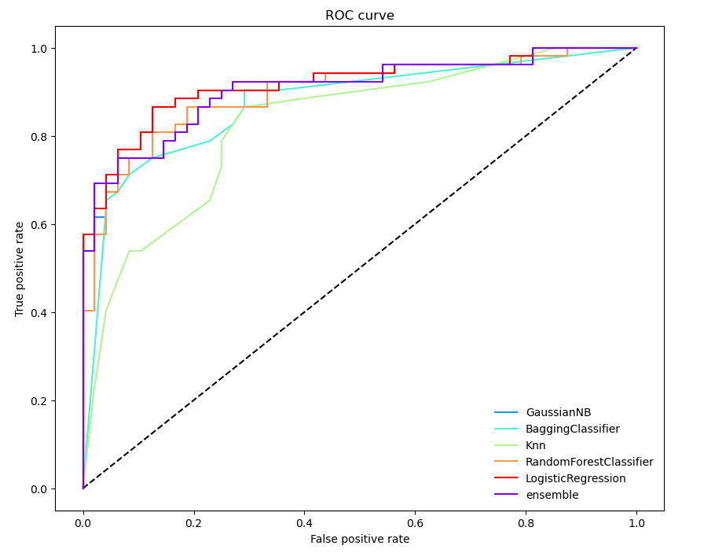

Slide 35
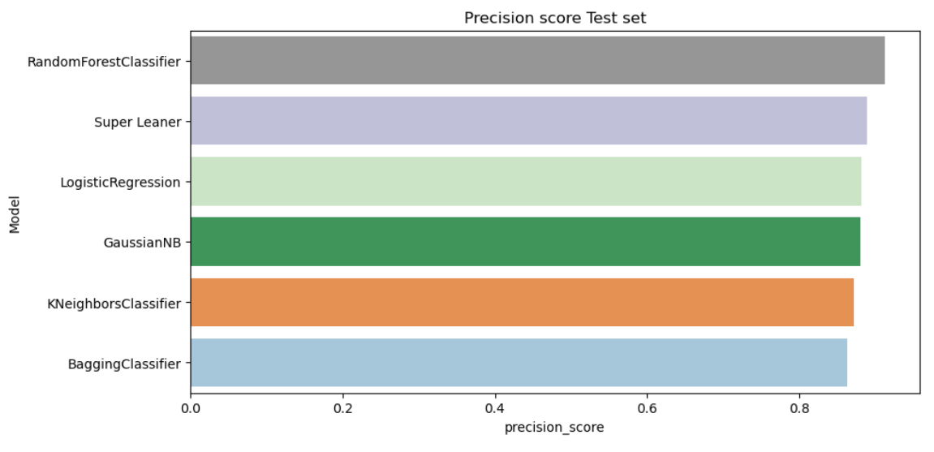
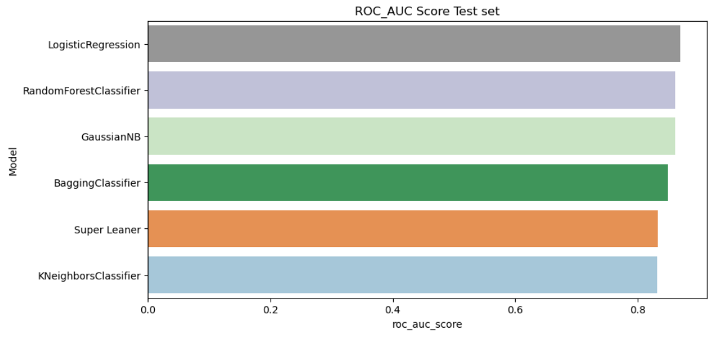
METRIC RESULTS ​

Slide 36
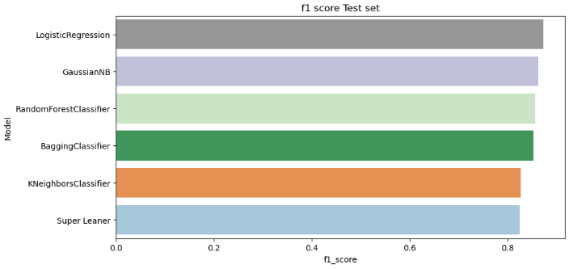
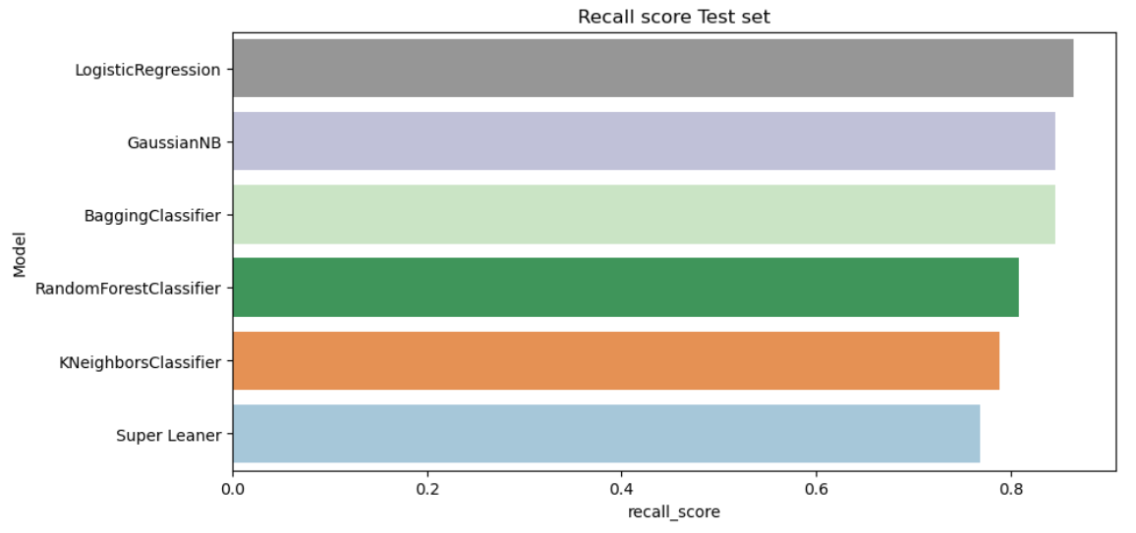
METRIC
RESULTS ​

Slide 37
CONCLUTION
According to the results, the best model is
1. NAÏVE BAYES CLASSIFICATION
2. LOGISTIC REGRESSION
3. RANDOM FOREST CLASSIFICATION

